Slide 1
Gene Shoemaker
Astrogeologist
Scientist Project by Dorothy Snowden
STS 201 – October 3, 2025

Slide 2
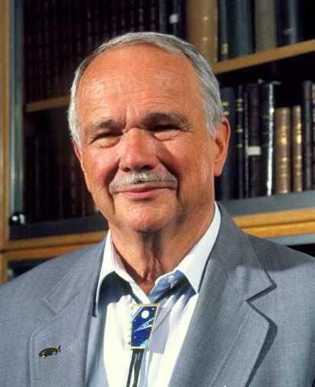
Dr. Eugene M. “Gene” Shoemaker
Born: 1928 - Los Angeles, CA
Died: 1997 – Alice Springs, Northern Territory, Australia
Married: 1951 to Carolyn Spellman Shoemaker
Considered the founder of modern astrogeology
Discovered the Shoemaker-Levy-9 Comet
Only man with ashes interred on the Moon

Slide 3
Astrogeology as an emerging science
Dr. Eugene “Gene” Shoemaker has been called the father of astrogeology, the discipline of studying the geological composition of celestial bodies. Shoemaker used his knowledge of geology and meteor craters to form ground-breaking concepts on how Earth has been affected by meteor impacts. His work challenged long-held tenants of uniformitarianism, instead emphasizing catastrophic events as a key to our planet’s history. Astrogeology studies draw on multiple scientific disciplines, such as astronomy, volcanology, petrology, paleomagnetism, and physics.

Slide 4
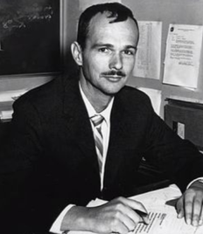
The young scientist prodigy
Gene Shoemaker enrolled in California Institute of Technology (Caltech) at the age of 16, graduating with a BS in Geology by the time he was 19. He went on to earn two Masters degrees and a Ph.D. from Princeton University.
His career began with the U.S. Geological Survey (USGS) mapping uranium on the Colorado Plateau and plutonium deposits in Nevada, as the nation focused on nuclear science during the Cold War.

Slide 5
Volcanoes to comets
Through his early work with the USGS, Gene Shoemaker searched for critical minerals and metamorphosed rocks in the craters resulting from nuclear bomb testing. He identified chemical compositions and characteristic of rocks from these craters and began to compare them to volcanic craters found across western states. This led to his discovery of the minerals Stishovite and Coesite, formed by high-pressure shock waves. His research focused on the petrology of “shock rocks” found along crater rims, helping prove the origins of many craters were not volcanic, as initially believed, but rather from extraterrestrial impacts as comets entered Earth’s stratosphere.

Slide 6
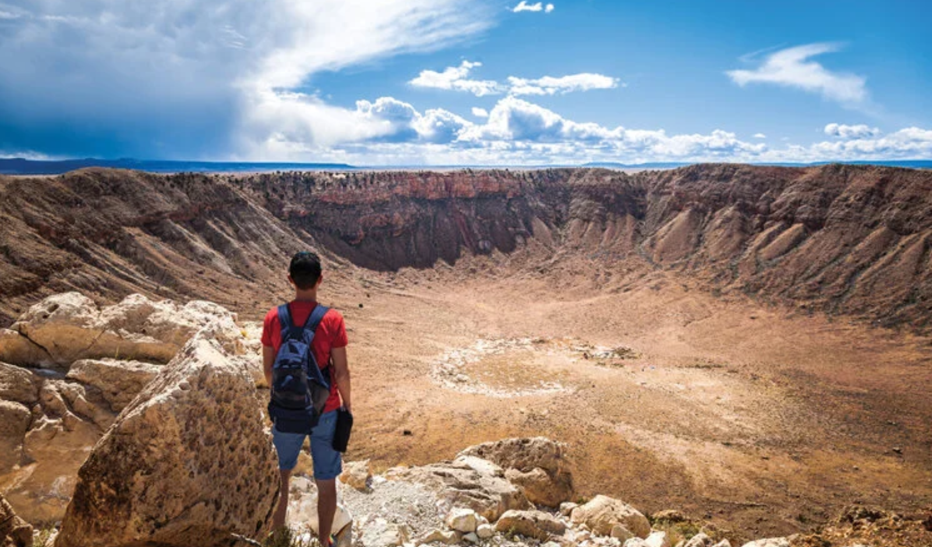
Arizona’s Barringer Meteor Crater
The USGS tasked Shoemaker with the first comprehensive geological analysis of the 4,000-foot-wide Barringer Meteor Crater east of Flagstaff, AZ. He postulated the meteorite which formed the crater was 150-tons of iron which vaporized upon contact, with a force equivalent to a 20-megaton nuclear bomb.

Slide 7
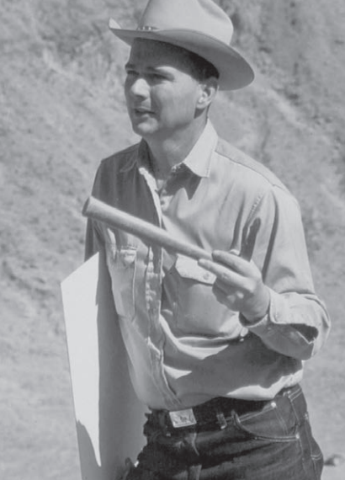
A great extinction of dinosaurs
Shoemaker believed impact events of the past could have been large enough to encompass the globe with enough dust to block sunlight and initiate a period of climate cooling responsible for the extinction of a majority of Earth’s life, including the dinosaurs. Geologists distinguish this event as the Cretaceous-Tertiary (K-T) Boundary of approximately 66 million years ago. Shoemaker is pictured here while mapping the floor of the Barringer Crater in Arizona.

Slide 8
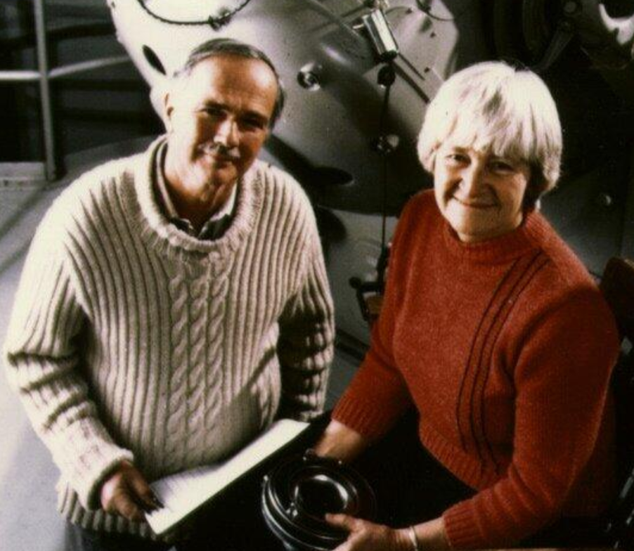
A dynamic duo emerges
Gene meet his future wife Carolyn Spellman at a friend’s wedding. Married in 1951, they became inseparable in all aspects of life. Carolyn’s interest in astronomy led her to discover 32 comets, earning her the nickname “Mrs. Comet.” She steered Gene’s study of impact craters to include planetary observations.

Slide 9
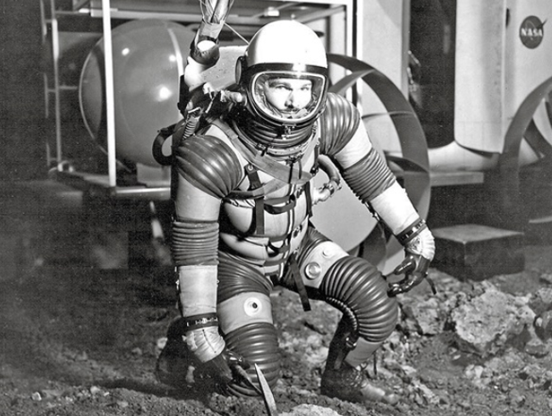
Collaboration of the USGS and NASA
The Shoemakers’ combined knowledge of meteor craters and astrology put them in a unique position as the Space Race began. Gene began training astronauts for the National Aeronautics and Space Administration (NASA) on geologic techniques of collecting planetary samples and convinced the agencies that conditions found in Arizona would provide a training ground for Apollo astronauts. Carolyn studied and identified near-earth objects (NEOs) and tracked comets.

Slide 10
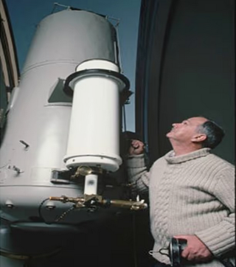
Astronaut dreams dashed
Any ideas Gene Shoemaker had of turning his attention to becoming an astronaut were dashed with the discovery he had Addison’s disease, an adrenal gland disorder which disqualified him from becoming an astronaut. His work with both the USGS and NASA saw him train numerous Apollo mission astronauts in remote sensing and applied geology.

Slide 11
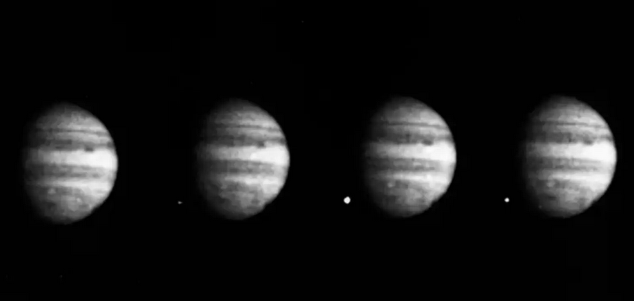
Shoemaker-Levy-9
Gene and Carolyn began tracking comets at Arizona’s Lowell Observatory, and with researcher David Levy, discovered the now-famous Shoemaker-Levy-9 comet in 1993. The team was able to observe pieces of the comet collide with Jupiter, a planet having a gravitational pull so strong Gene described it as a “cosmic vacuum cleaner.” This was the first time man witnessed a planetary collision.

Slide 12
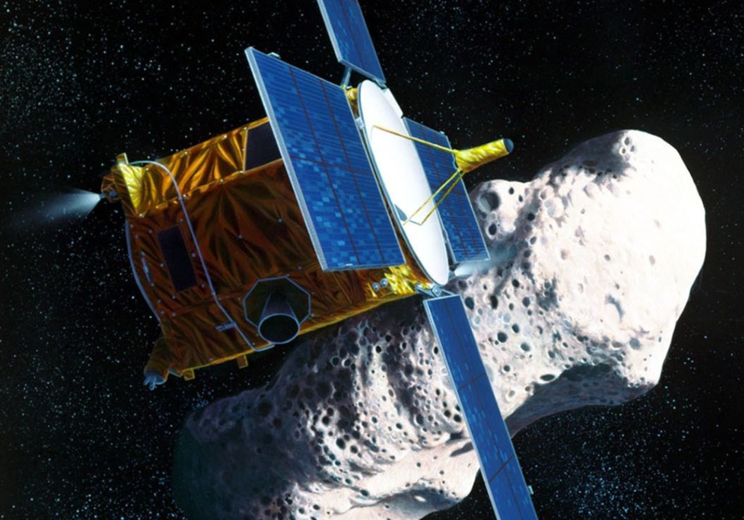
NEAR Shoemaker
Shoemaker’s quest for extraterrestrial rocks involved him in the NASA project named Near Earth Asteroid Rendezvous-Shoemaker (NEAR-Shoemaker). For the first time, a spacecraft orbited an asteroid and successfully landed on it in 2001.

Slide 13
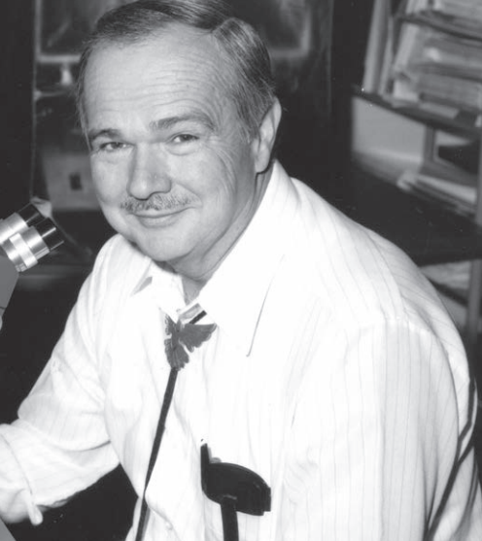
Connecting Shoemaker’s work to STS considerations
Gene Shoemaker fit the stereotypical scientist model in that he was a white male of exceptional intelligence. Working in a USGS or NASA office, he dressed professionally while keeping the western flair of jeans, boots and bolo tie he favored for field work. Where he departed from the typical scientist was his open dependence on his wife Carolyn. As a couple, in work and all aspects of life, she was his equal.

Slide 14
A quote from Carolyn on working with her husband:
“Without Gene, I would never have known the excitement of planetary science nor have had the opportunities I did to work in that area; without me, he often said his search for asteroids and comets and then the Australian cratering work would never have been attempted. Together, we could do more than either of us alone.”
Carolyn Shoemaker, 1999

Slide 15
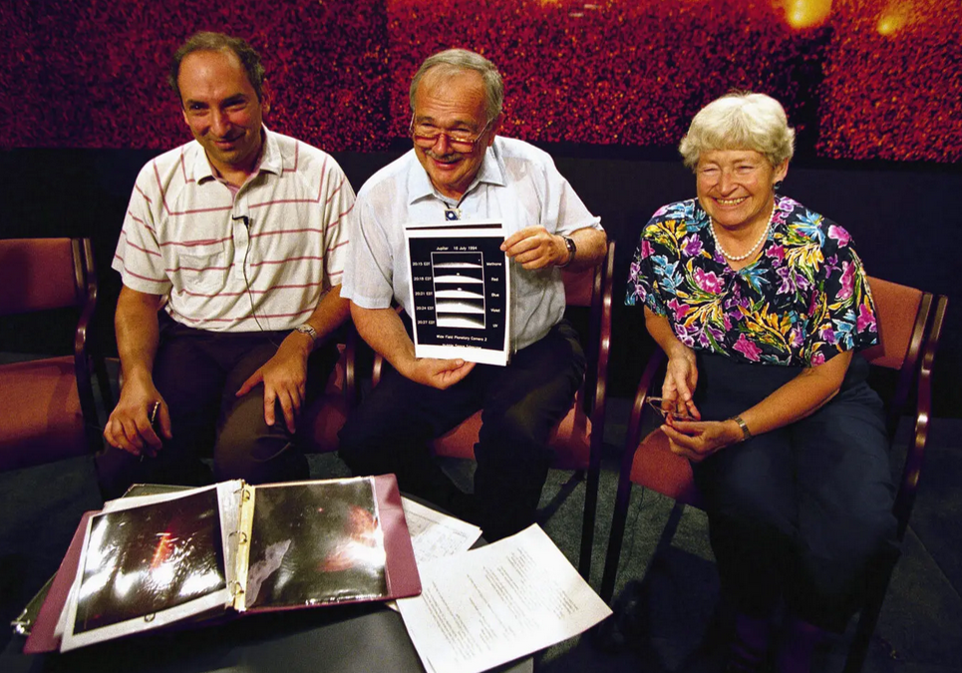
Shared scientific achievements
Gene’s work identifying comets and most notably the Shoemaker-Levy-9 was a combined effort with his wife and astrologist David Levy. Gene happily shared the spotlight, and the trio garnered individual honors from the scientific community throughout their careers. Pictured from left to right are David Levy, Eugene Shoemaker, and Carolyn Shoemaker, during a presentation about the comet bearing their names.

Slide 16
Learning to fly
In 1992, over lunch, Gene and Carolyn related to the author how their desire to see impact craters from the sky led to the purchase of a small plane. Gene piloted the flights until one day, it occurred to Carolyn that if something were to happen to her husband, she had no idea how to control, much less land, the plane. Thus, she obtained a pilot’s license and shared flight duties.
Ironically, a plane crash was not what ended their happy life. While studying craters near Alice Springs, Australia in 1997, the pair had a head-on automobile accident, which killed Gene and seriously injured Carolyn. She recovered and continued her planetary work, serving as a tribute to her devoted partner. In all, “Mrs. Comet” discovered 377 numbered asteroids before she died at age 92.

Slide 17
Honored by the scientific community
The work of Eugene Shoemaker had a lasting impact on how geology is utilized in the study of impact craters found on Earth and other planetary bodies. He brought public awareness to our fragile state of existence in the face of risks posed by meteors which could impact Earth. His years at USGS and NASA helped establish the Shoemaker Astrogeology Center at Flagstaff, Arizona. He was awarded the National Medal of Sciences by President George H. W. Bush in 1992 and was a co-recipient, with his wife, of the Ritttenhouse Medal of the Rittenhouse Astronomical Society in 1988.

Slide 18
He made it to the Moon after all
When Gene Shoemaker passed, one of his colleagues arranged for some of his ashes to be included on the Lunar Prospector spacecraft. A capsule holding a bronze plate engraved in his honor, one ounce of ashes, and a piece of the Barringer Meteor Crater were interred on the Moon’s south pole. Shoemaker is the only human to be remembered in such a manner.

Slide 19
References
National Academy of Sciences, (2024). Eugene Shoemaker, https://www.nasonline.org>wp-content>uploads>2024>06>shoemaker-eugene.pdf, accessed 9/3/2025.
USGS, (n.d.). Astrogeology remembers Dr. Gene Shoemaker, www.usgs.gov/centers/astrogeology-science-center/new/astrogeology-remembers-dr-gene-shoemaker , accessed 9/3/2025.
Christopher, M. (2022). Eugene M. Shoemaker, www.ebesco.com/research-starters/history/eugene-m-shoemaker , accessed 9/17/2025

Slide 20
References
NPR, (2026). A fitting tribute for a stargazing love-a trip to the Moon. www.npr.org/2016/07/08/485089053/a-fitting-tribute-for-a-stargazing-love-a-trip-to-the-moon , accessed 9/17/2025.
John Hopkins University Applied Physics Laboratory, (2001).Near Earth Asteroid Rendezvous-Shoemaker, NEAR Shoemaker, www.near.jhapl.edu/news/flash/01feb28.html , accessed 9/17/2025.
American Astronomical Society, (2022), Bulletin of the AAS, K. Schindler, Carolyn S. Shoemaker, www.baas.aas.org/pub/2022:018/release/2, accessed 10/3/2025.

Slide 21
Photo Credits
Levy & Shoemaker, USGS, Lowell Observatory, (1994), www.houstonpublicmedia.org/articles/shows/Houston-matters/2024/08/16/496920/David, accessed 9/5/2025.
Carolyn Shoemaker, USGS, www.usgs.gov/centers/astrogeology-science-center/news/past-and-future-celebrations-carolyn
Eugene M. Shoemaker, USGS Astrogeology, multiple images, www.usgs.gov accessed 9/1/2025 – 9/30/2025.
Barringer Crater, www.barringercrater.com/for-visitors, accessed 9/17/2025.

